Slide 1

Smart Security Camera

Slide 2

Raspiberry pi configuration and set up
Take a dedicated sd card and download noobs software from Raspberrypi.org
https://www.raspberrypi.org/downloads/noobs/
Format the SD card by sd card formatter
Extract the files on to the sd card
Connect HDMI to monitor, Micro Usb for power, mouse and sd card
Then raspiberry pi start installing the software from boot menu and select rasbian software

Slide 3
Connecting Raspberry pi through Ethernet
Install xrdp on your computer with following command to acess remote desktop connection
sudo apt-get install xrdp
Scan with advanced ip scanner to get ip address of pi
Open remote desktop on your laptop with ip address and access your Rpi desktop with your credentials

Slide 4
Connection of camera to Raspberry Pi
Open the terminal and run Sudo raspi-config
Select interface options and enable pi camera then reboot the system
You can take the picture with raspistill –o image.jpg

Slide 5

Open CV installation
expand your filesystem to include all available space on your micro-SD card: sudo raspi-config
you should select the first option, “1. Expand File System”, hit Enter
Arrow down to the “<Finish>” button, and then reboot your Pi:
sudo reboot
You can verify that the disk has been expanded by executing df -h
OpenCV, along with all its dependencies, will need a few gigabytes during the compile, so you should delete the Wolfram engine to free up some space on your Pi:sudo apt-get purge wolfram-engine
The first step is to update and upgrade any existing packages:
sudo apt-get update
sudo apt-get upgrade
We then need to install some developer tools, including CMake, which helps us configure the OpenCV build process:
sudo apt-get install build-essential cmake pkg-config
Next, we need to install some image I/O packages that allow us to load various image file formats from disk. Examples of such file formats include JPEG, PNG, TIFF, etc.:sudo apt-get install libjpeg-dev libtiff5-dev libjasper-dev libpng12-dev

Slide 6
Open CV installation
Just as we need image I/O packages, we also need video I/O packages. These libraries allow us to read various video file formats from disk as well as work directly with video streams:
sudo apt-get install libavcodec-dev libavformat-dev libswscale-dev libv4l-dev
sudo apt-get install libxvidcore-dev libx264-dev
The OpenCV library comes with a sub-module named highgui which is used to display images to our screen and build basic GUIs. In order to compile the highgui module, we need to install the GTK development library:sudo apt-get install libgtk2.0-dev
Many operations inside of OpenCV (namely matrix operations) can be optimized further by installing a few extra dependencies:
sudo apt-get install libatlas-base-dev gfortran
Lastly, let’s install both the Python 2.7 and Python 3 header files so we can compile OpenCV with Python bindings:
sudo apt-get install python2.7-dev python3-dev
let’s grab the 3.1.0 archive of OpenCV from the official OpenCV repository:
cd ~
wget -O opencv.zip https://github.com/Itseez/opencv/archive/3.1.0.zip
unzip opencv.zip

Slide 7
Open CV installation
we also need to grab the opencv_contrib repository as well:
wget -O opencv_contrib.zip https://github.com/Itseez/opencv_contrib/archive/3.1.0.zip
unzip opencv_contrib.zip
Before we can start compiling OpenCV on our Raspberry Pi 3, we first need to install pip , a Python package manager:
wget https://bootstrap.pypa.io/get-pip.py
sudo python get-pip.py
It’s standard practice in the Python community to be using virtual environments of some sort, so I highly recommend that you do the same:
sudo pip install virtualenv virtualenvwrapper
sudo rm -rf ~/.cache/pip
Now that both virtualenv and virtualenvwrapper have been installed, we need to update our ~/.profile file to include the following lines at the bottom of the file:
export WORKON_HOME=$HOME/.virtualenvs
source /usr/local/bin/virtualenvwrapper.sh
echo -e "\n# virtualenv and virtualenvwrapper" >> ~/.profile
$ echo "export WORKON_HOME=$HOME/.virtualenvs" >> ~/.profile
$ echo "source /usr/local/bin/virtualenvwrapper.sh" >> ~/.profile

Slide 8
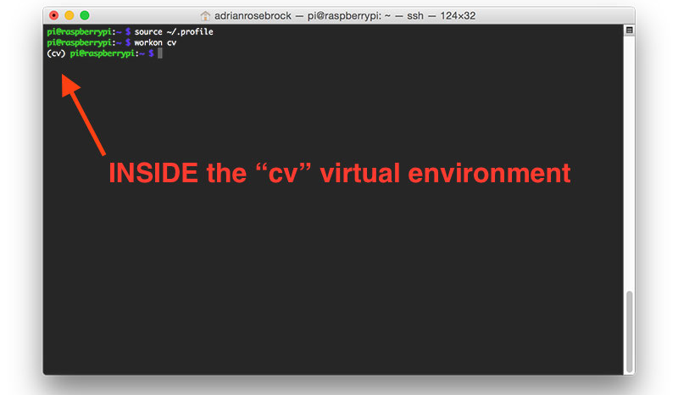
Open CV installation
Now that we have our ~/.profile updated, we need to reload it to make sure the changes take affect. You can force a reload of your ~/.profile file by:
Logging out and then logging back in.
Closing a terminal instance and opening up a new one
Or my personal favorite, just use the source command: source ~/.profile
Creating your Python virtual environment
Next, let’s create the Python virtual environment that we’ll use for computer vision development:
want to use Python 3, you’ll want to use this command instead:
mkvirtualenv cv -p python3
How to check if you’re in the “cv” virtual environment
After that, you can use workon and you’ll be dropped down into your virtual environment:source ~/.profile
$ workon cv

Slide 9
Compile and Install OpenCV
Installing NumPy on your Raspberry Pi
Assuming you’ve made it this far, you should now be in the cv virtual environment (which you should stay in for the rest of this tutorial). Our only Python dependency is NumPy, a Python package used for numerical processing:
pip install numpy
workon cv
cd ~/opencv-3.1.0/
$ mkdir build
$ cd build
$ cmake -D CMAKE_BUILD_TYPE=RELEASE \
-D CMAKE_INSTALL_PREFIX=/usr/local \
-D INSTALL_PYTHON_EXAMPLES=ON \
-D OPENCV_EXTRA_MODULES_PATH=~/opencv_contrib-3.1.0/modules \
-D BUILD_EXAMPLES=ON ..

Slide 10
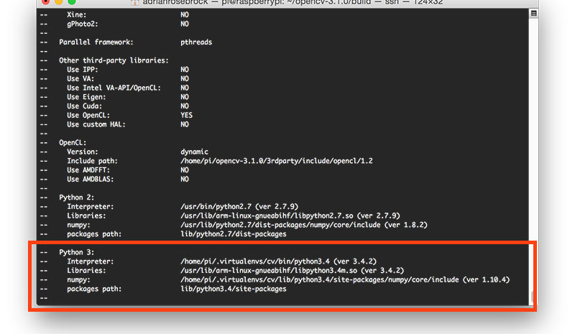
Compile and Install OpenCV
Now, before we move on to the actual compilation step, make sure you examine the output of CMake!

Slide 11
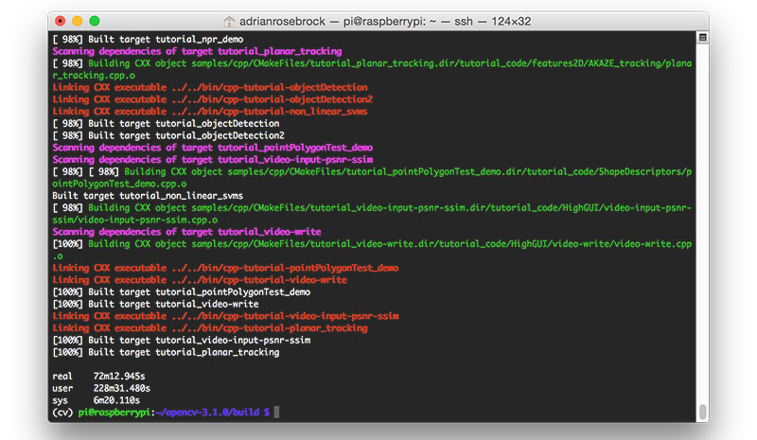
Compile and Install OpenCV
Finally, we are now ready to compile OpenCV:
make clean
Make
It will take 2 hours to compile. Be patient
The compile output should be like this

Slide 12
Installation of open CV
all you need to do is install OpenCV 3 on your Raspberry Pi 3:
sudo make install
sudo ldconfig
We’re almost done — just a few more steps to go and you’ll be ready to use your Raspberry Pi 3 with OpenCV 3.
ls -l /usr/local/lib/python3.4/site-packages/
total 1852
-rw-r--r-- 1 root staff 1895932 Mar 20 21:51 cv2.cpython-34m.so
I honestly don’t know why, perhaps it’s a bug in the CMake script, but when compiling OpenCV 3 bindings for Python 3+, the output .so file is named cv2.cpython-34m.so (or some variant of) rather than simply cv2.so (like in the Python 2.7 bindings).
Again, I’m not sure exactly why this happens, but it’s an easy fix. All we need to do is rename the file:
cd /usr/local/lib/python3.4/site-packages/
$ sudo mv cv2.cpython-34m.so cv2.so
After renaming to cv2.so , we can sym-link our OpenCV bindings into the cv virtual environment for Python 3.4:
cd ~/.virtualenvs/cv/lib/python3.4/site-packages/
$ ln -s /usr/local/lib/python3.4/site-packages/cv2.so cv2.so

Slide 13
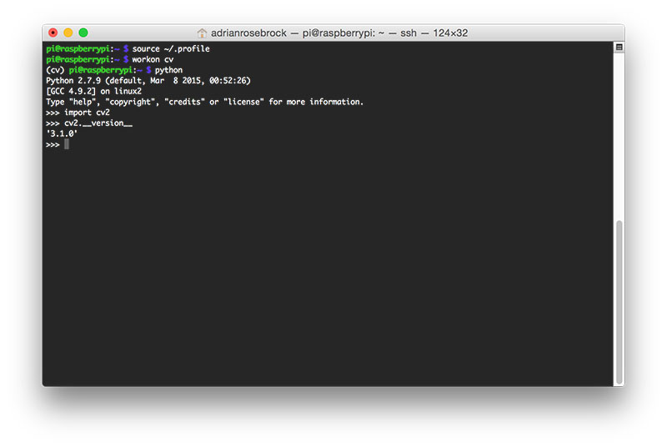
Testing your OpenCV 3 install
Open up a new terminal, execute the source and workon commands, and then finally attempt to import the Python + OpenCV bindings:
source ~/.profile
$ workon cv
$ python
>>> import cv2
>>> cv2.__version__
'3.1.0'
>>>
Once OpenCV has been installed, you can remove both the opencv-3.1.0 andopencv_contrib-3.1.0 directories to free up a bunch of space on your disk:
rm -rf opencv-3.1.0 opencv_contrib-3.1.0

Slide 14
Mail Code
import smtplib from email.MIMEMultipart import MIMEMultipart from email.MIMEText import MIMEText from email.MIMEImage import MIMEImage # Email you want to send the update from (only works with gmail) fromEmail = 'email@gmail.com' # You can generate an app password here to avoid storing your password in plain text # https://support.google.com/accounts/answer/185833?hl=en fromEmailPassword = 'password' # Email you want to send the update to toEmail = 'email2@gmail.com' def sendEmail(image): msgRoot = MIMEMultipart('related') msgRoot['Subject'] = 'Security Update' msgRoot['From'] = fromEmail msgRoot['To'] = toEmail msgRoot.preamble = 'Raspberry pi security camera update' msgAlternative = MIMEMultipart('alternative') msgRoot.attach(msgAlternative) msgText = MIMEText('Smart security cam found object') msgAlternative.attach(msgText) msgText = MIMEText('<img src="cid:image1">', 'html') msgAlternative.attach(msgText) msgImage = MIMEImage(image) msgImage.add_header('Content-ID', '<image1>') msgRoot.attach(msgImage) smtp = smtplib.SMTP('smtp.gmail.com', 587) smtp.starttls() smtp.login(fromEmail, fromEmailPassword) smtp.sendmail(fromEmail, toEmail, msgRoot.as_string()) smtp.quit()

Slide 15
Main Code
import cv2 import sys from mail import sendEmail from flask import Flask, render_template, Response from camera import VideoCamera import time import threading import video import numpy as np email_update_interval = 600 # sends an email only once in this time interval video_camera = VideoCamera(flip=True) # creates a camera object, flip vertically object_classifier = cv2.CascadeClassifier("models/fullbody_recognition_model.xml") # an opencv classifier # App Globals (do not edit) app = Flask(__name__) last_epoch = 0 def check_for_objects(): global last_epoch while True:

Slide 16
Main Code
try: frame, found_obj = video_camera.get_object(object_classifier) if found_obj and (time.time() - last_epoch) > email_update_interval: last_epoch = time.time() print "Sending email..." sendEmail(frame) print "done!" except: print "Error sending email: ", sys.exc_info()[0] @app.route('/') def index(): return render_template('index.html') def gen(camera): while True: frame = camera.get_frame() yield (b'--frame\r\n' b'Content-Type: image/jpeg\r\n\r\n' + frame + b'\r\n\r\n') @app.route('/video_feed') def video_feed(): return Response(gen(video_camera), mimetype='multipart/x-mixed-replace; boundary=frame') if __name__ == '__main__': t = threading.Thread(target=check_for_objects, args=()) t.daemon = True t.start() app.run(host='0.0.0.0', debug=False)

Slide 17
Code
source ~/.profile
workon cv
cd Smart-Security-Camera
install the dependencies for the project
To get emails when objects are detected, you'll need to make a couple modifications to the mail.py file. Open mail.py with vim vim mail.py , then press i to edit. Scroll down to the following section
# Email you want to send the update from (only works with gmail)
fromEmail = 'myemail@gmail.com’
fromEmailPassword = 'password1234’
# Email you want to send the update to
toEmail = 'anotheremail@gmail.com’
and replace with your own email/credentials. The mail.py file logs into a gmail SMTP server and sends an email with an image of the object detected by the security camera.

Slide 18
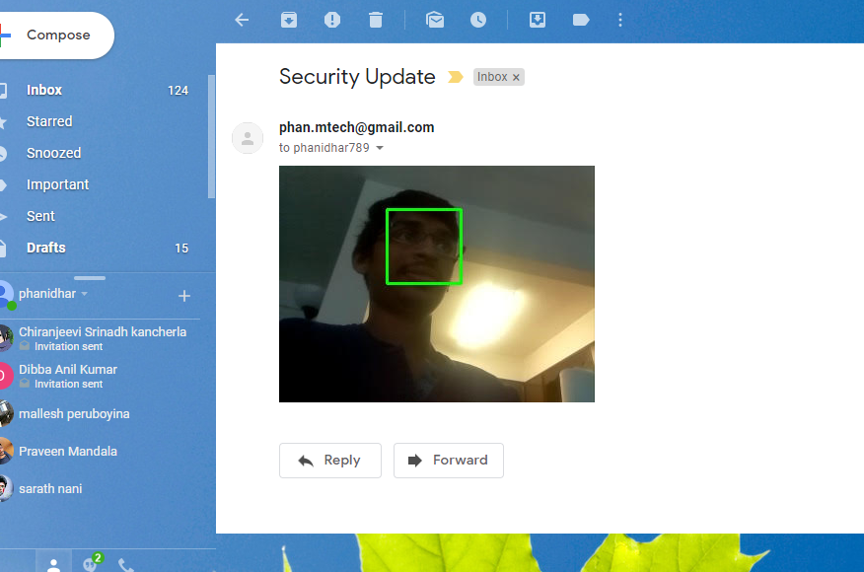
Output Face Recognition

Slide 19
References
You can also modify the main.py file to change some other properties.
email_update_interval = 600
# sends an email only once in this time interval
video_camera = VideoCamera(flip=True) # creates a camera object, flip vertically object_classifier = cv2.CascadeClassifier("models/fullbody_recognition_model.xml")
Run mai.py
Check your mail box
References:
https://www.hackster.io/hackershack/smart-security-camera-90d7bd
https://www.pyimagesearch.com/2016/04/18/install-guide-raspberry-pi-3-raspbian-jessie-opencv-3/

